Slide 1
Exploring Malaysia's Double Tax Deduction (DTD) for Research and Development Qualifying Expenses
Azlin Abd Jamil (Ph.D., P. Tech)
Pegawai Tadbir
Universiti Teknologi Malaysia
Persatuan Pegawai Pentadbir dan Ihktisas (PERTISAS)

Slide 2
Contents of Presentation
Exploring Malaysia's Double Tax Deduction (DTD) for Research and Development Qualifying Expenses
Introduction | Overview of Malaysia's Double Tax Deduction for R&D, introducing the research team from Universiti Teknologi Malaysia.
Literature Review | Analysis of global R&D tax incentives and specific challenges within Malaysia.
Methodology | Description of qualitative research methods and a visual flowchart of the study process.
Findings & Results | Highlights of key benefits and placeholders for upcoming data visuals.
Discussion | Insights on the tax relief impacts and broader effects on Malaysia's innovation ecosystem (UTM).
Conclusion and Recommendations | Summary of findings with strategic recommendations for policy enhancements.
Scope:
Organizational Management Best Practices at the Universiti of Technology Malaysia
Researchers / Authors: Azlin Abd Jamil | Sapiah Sulaiman | Nazirul Naim Rushdan | Nurul Huda Zamzuri
Nurfarhain Mohamed Rusli | Nadzreeq Bin Nor Majid | Ahmad Lutfilhazim Camallil

Slide 3
Introduction
Exploring Malaysia's Double Tax Deduction (DTD) for Research and Development Qualifying Expenses
This study examines Malaysia's Income Tax Act 1967, focusing on Section 34B, which introduces Double Tax Deduction (DTD) for eligible S&T R&D activities. Using qualitative methods, the study reviewed the procedures for qualifying expenses and the impact on the local innovation ecosystem. Insights gathered from ten (10) respondents of local industry and researchers who benefited from the DTD incentive. Results indicate that the DTD incentive enhances collaboration, transparency and competitiveness while promoting partnerships with local industries. Although DTD offers many benefit, it requires a comprehensive understanding in order to incorporate eligible activities and expenses effectively. Overall, the DTD fosters local innovation and supports national socioeconomic development.

Slide 4
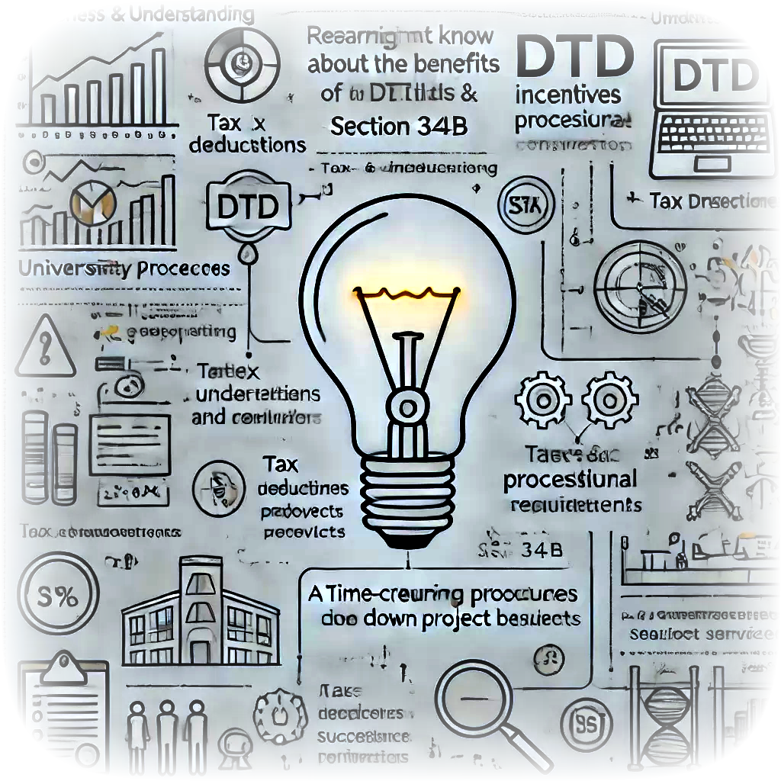
Background and Issues
Exploring Malaysia's Double Tax Deduction (DTD) for Research and Development Qualifying Expenses
UTM, a technology and engineering-based university, has been recognized as an Approved Research Institute by the Ministry of Finance (MOF) since 1991. However, the benefits are still not fully utilized, which could enhance UTM’s R&D visibility and performance.

Slide 5
Background and Issues
Exploring Malaysia's Double Tax Deduction (DTD) for Research and Development Qualifying Expenses
1
Researchers often lack awareness of DTD benefits and Section 32B, find incentives irrelevant, and are unaware of university services.
3
Maintaining accurate compliance documentation is challenging, and insufficient support hinders effective compliance and pitching.
4
5
Complex university processes and resistance to new procedures delay R&D approvals and project starts, while busy schedules complicate compliance.
Resistance to new compliance measures and a lack of case studies reduce motivation.
2
The lack of successful case studies, unclear guidelines, and inconsistent procedures lead to compliance issues.
Researchers often lack awareness of DTD benefits and Section 32B, find incentives irrelevant, and are unaware of university services.
7
8
Administrative inefficiencies and slow financial transactions impact project management and progress.
9
Poor communication and coordination among researchers, administration, and finance cause delays and slow issue resolution. Misunderstandings further worsen these problems.
Inadequate training on pitching and DTD compliance creates gaps in understanding.
Insufficient ability to transfer knowledge to industry to address their issues and build trust
6
Notes:
Researchers often lack awareness of DTD benefits and Section 32B, find incentives irrelevant, and are unaware of university services.
The lack of successful case studies, unclear guidelines, and inconsistent procedures lead to compliance issues.
Maintaining accurate compliance documentation is challenging, and insufficient support hinders effective compliance and pitching.
Poor communication and coordination among researchers, administration, and finance cause delays and slow issue resolution. Misunderstandings further worsen these problems.
Complex university processes and resistance to new procedures delay R&D approvals and project starts, while busy schedules complicate compliance.
Resistance to new compliance measures and a lack of case studies reduce motivation.
Inadequate training on pitching and DTD compliance creates gaps in understanding.
Administrative inefficiencies and slow financial transactions impact project management and progress.

Slide 6
Background and Issues
Exploring Malaysia's Double Tax Deduction (DTD) for Research and Development Qualifying Expenses
Intellectual Capital
Researchers don't know about the benefits of DTD and Section 32B.
DTD incentives may seem irrelevant to some researchers.
Researchers may not be aware of available university services.
A lack of successful case studies can reduce motivation.
Tax deductions and compliance can be confusing.
Inconsistent procedures create compliance confusion.
Ambiguous guidelines cause errors and confusion.
Financial Capital
Maintaining accurate compliance documentation can be challenging.
Insufficient support can create barriers to compliance and pitching.
Social Capital
Communication between researchers and administration might be poor.
Misunderstandings among project managers and researchers may occur.
Poor coordination among finance and research units can cause delays.
Ineffective feedback mechanisms can slow down issue resolution.
Institutional Capital
Complex university processes can slow down R&D approvals.
Approval delays can affect project start times.
Resistance to adopting new processes and compliance.
Busy schedules make it hard for researchers to comply.
Cultural Capital
Adopting new processes and compliance measures may face resistance.
Lack of successful case studies reduces motivation.
Technological Capital
Insufficient training on pitching and tax benefits.
Lack of training on DTD compliance and pitching.
Physical Capital
Administrative support might be delayed or inefficient.
Slow financial transactions can impact project management.

Slide 7
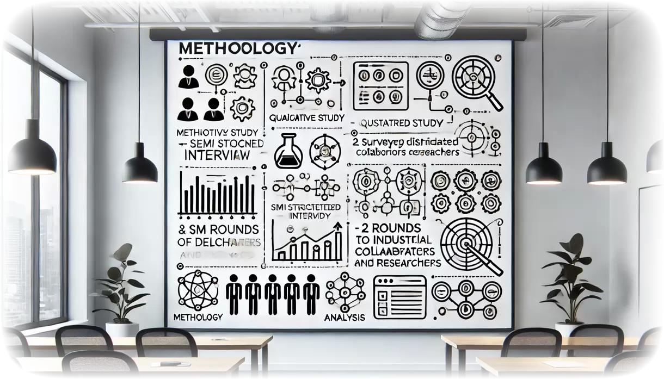
Exploring Malaysia's Double Tax Deduction (DTD) for Research and Development Qualifying Expenses

Slide 8
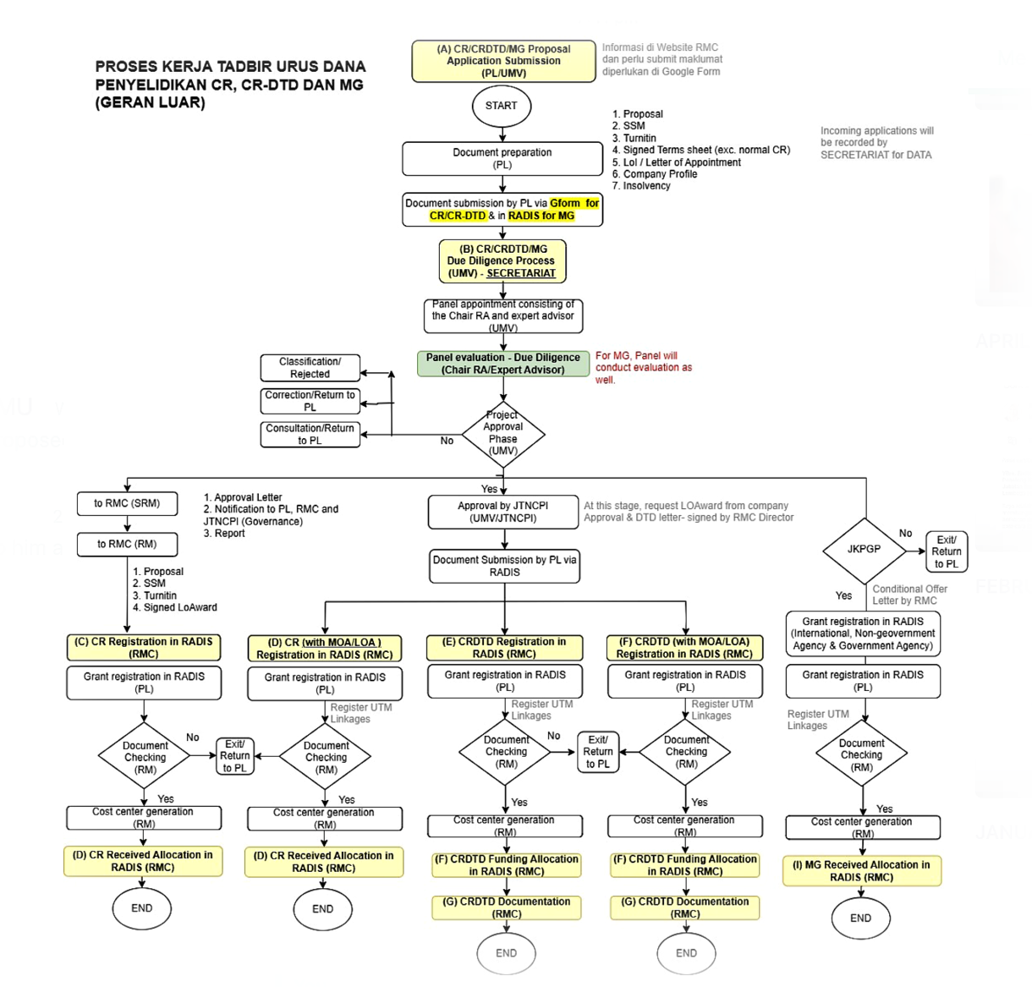
Findings & Results
Exploring Malaysia's Double Tax Deduction (DTD) for Research and Development Qualifying Expenses
To address issues discussed earlier, UTM has refined the Double Tax Deduction (DTD) processes at UTM including:
Officers are trained to become experts on the criteria for DTD and to conduct effective awareness and interactive sessions with stakeholders, including researchers and industrial collaborators.
Researchers submit their applications through a centralized online form managed by the UTM Research Management Centre (RMC).
An appointed panel of experts reviews application submissions to ensure compliance with ITA 1967 Section 34B, allowing only qualified S&T R&D applications to proceed to project commencement.
The RMC manages and oversees all records related to expenses and research activities funded by industry or eligible companies.
Companies transfer funds to the UTM RMC following project registration, and receipts are issued by the RMC.
The RMC monitors projects according to the approved proposal, and companies apply for DTD from the IRB Malaysia for their accrued expenses during the year.

Slide 9
Conclusion and Recommendations
Exploring Malaysia's Double Tax Deduction (DTD) for Research and Development Qualifying Expenses
Conclusion:
The study reveals that while UTM has improved its Double Tax Deduction (DTD) processes through enhanced training, centralized applications, and rigorous compliance checks, challenges remain in knowledge transfer and communication, which are crucial for gaining industry trust.
Recommendations on DTD to Other Research Institutions:
Expand training programs for officers and researchers on DTD benefits and compliance requirements.
Improve communication channels between researchers, administration, and industry partners to enhance collaboration and understanding.
Simplify application and compliance procedures, providing clear guidelines to reduce complexity.
Promote successful case studies to demonstrate DTD benefits and motivate stakeholders.
Implement continuous monitoring and feedback systems to address issues promptly.
Collaborate with other universities to exchange best practices and boost overall effectiveness.
Notes:
Conclusion:
The study reveals that while UTM has improved its Double Tax Deduction (DTD) processes through enhanced training, centralized applications, and rigorous compliance checks, challenges remain in knowledge transfer and communication.
Recommendations:
Expand training for officers and researchers on DTD benefits and compliance. Improve communication between researchers, administration, and industry partners. Simplify processes and provide clearer guidelines to reduce complexity. Share successful case studies to demonstrate DTD benefits and motivate stakeholders. Implement continuous monitoring and feedback systems to address issues promptly. Collaborate with other universities to exchange best practices and enhance overall effectiveness.

Slide 10
Exploring Malaysia's Double Tax Deduction (DTD) for Research and Development Qualifying Expenses
THANK YOU!
Notes:
Conclusion:
The study reveals that while UTM has improved its Double Tax Deduction (DTD) processes through enhanced training, centralized applications, and rigorous compliance checks, challenges remain in knowledge transfer and communication.
Recommendations:
Expand training for officers and researchers on DTD benefits and compliance. Improve communication between researchers, administration, and industry partners. Simplify processes and provide clearer guidelines to reduce complexity. Share successful case studies to demonstrate DTD benefits and motivate stakeholders. Implement continuous monitoring and feedback systems to address issues promptly. Collaborate with other universities to exchange best practices and enhance overall effectiveness.

